Slide 1


DREAM LEARNER’S
SUBMITTED TO :- SUBMITTED BY:-
MR.PAVAN YOGESH
HOSHIYAR SNGH
LALIT KUMAR
SUBHAM SAINI
NISHU RANI

Slide 2

SANJEEVANI

Slide 3

PROBLEM STATEMENT
RATIO OF DOCTOR IS IMPERFECT.
LACK OF DOCTOR IN MANY AREA’S.
PATIENTS FACES MANY PROBLEMS.

Slide 4
Solution proposed
This project tells about in which area we need doctors on the basis of their specialization.
It tells to the specialized medical students that in which area probability of getting job is higher according to their specialization.

Slide 5
Challenges faced
DATA COLLECTION
WEIGHT CALCULATION

Slide 6

METHODOLOGY used
CLASSIFICATION ALGO.
CUSTOM ALGO.

Slide 7

DATA FIELDS REQUIRED
Student details
First name
Last name
Email
Gender
Specialization
Eligibility
Requirements
Specialization
Location
Vacancy

Slide 8
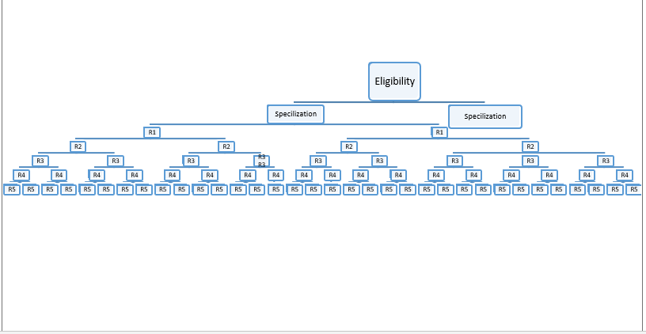
Decision tree

Slide 9
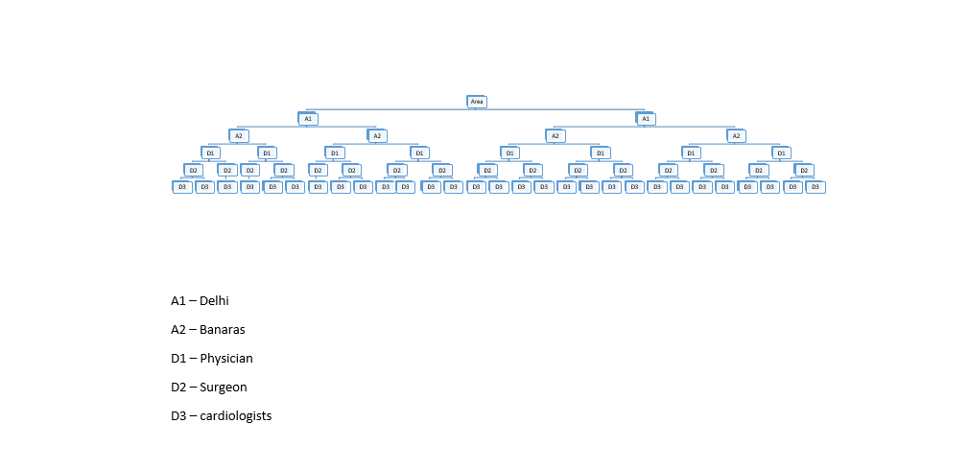
Decision tree

Slide 10
FUTURE SCOPE
We will add more category of specialized doctors.
We will also add category of those experienced doctors who are ready/want to change their location.
We will also predict the areas which is near to their present location.

Slide 11
DEMO

Slide 12
THANK YOU

